Slide 1
Christian Discipleship, Academic Excellence, and Great Love

Slide 2
Middle School Curriculum Overview
Core Classes:
Humanities
Mathematics
Science
Language Arts
Religion
Enrichment Classes:
Art
Spanish
Band
Choir

Slide 3
Humanities
Interdisciplinary course that blends history and cultural ideas with philosophy, theology, and religion
Intersects history and culture with complex questions like…
What is the purpose of our lives?
How are we to make sense of the world?
Is there a right way to live?
Our approach helps students to better understand the past as well as the present and reinforces our Judeo-Christian view of the world
Topics include: Ancient civilizations, American history, modern world history while learning geography, Economics, Civics, Philosophy, and various cultures

Slide 4
Religion
7th Grade
The overarching theme is Jesus and the Gospel message with an emphasis on unifying themes in Scripture
Students will focus on the Gospel message, the Sacraments, and Prayer
6th Grade
The overarching theme is divine revelation and sacred scripture
Students will focus on interpreting and understanding scripture while studying the story of salvation through the bible
8th Grade
The overarching theme is personal growth in our relationship with Jesus with an emphasis on vocation and our responsibilities to God and each other
Students will focus on Church history, morality, citizenship and government, and God’s plan for love and marriage

Slide 5
Science
Life Science
“Life Science Exploration: From Cells to Ecosystems" is a dynamic middle school course that takes students on a comprehensive journey through the intricate world of living organisms. This course is designed to provide an in-depth understanding of scientific methods, delve into the characteristics and needs of living organisms, explore the microscopic realm, survey the six kingdoms of life, unravel the mysteries of genetics, and examine the interconnectedness of ecological systems.
Earth Science
Embark on a thrilling journey through the dynamic world of Earth Science with our middle school course, "Earth Science Exploration: From Rocks to the Cosmos." This comprehensive program is designed to unravel the mysteries of scientific methods, geology, astronomy, and meteorology. Students will gain a profound understanding of Earth's structure, composition, celestial bodies, and atmospheric phenomena.
Physical Science
"Exploring Physical Science: From Matter to Motion" is an exciting exploration of the fundamental principles of physical science. This comprehensive program is designed to ignite curiosity, foster critical thinking, and deepen understanding in the fields of chemistry and physics. Students will unravel the mysteries of scientific methods, delve into the nature of matter, explore chemical reactions, and understand the principles governing motion, energy, and electromagnetism.

Slide 6
Math 6
​​Welcome to Math 6! In this sixth-grade math class, our main emphasis is on building a strong foundation in fractions, decimals, and order of operations. We will also introduce new concepts like…
Solving equations
Exploring measurements
Delving into geometry
Mastering graphing
Understanding functions.
Math 6 is designed to lay the groundwork for Algebra logic, ensuring a solid preparation for future mathematical challenges. Get ready to enhance your mathematical skills and build the confidence to tackle more advanced concepts!

Slide 7
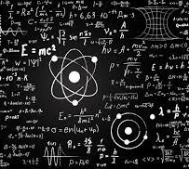
Pre-Algebra
Welcome to Pre-Algebra! Building upon the foundations of Math 6, this course…
Introduces the crucial concept of signed numbers
Explores negative and rational numbers
Delves into algebraic reasoning
Tackles multi-step equations
Work with percents, functions, and probability.
Additionally, we'll explore 2 and 3-dimensional figures, geometry principles, and the skills of collecting and analyzing data. Pre-Algebra aims to establish a robust understanding of these concepts, providing a solid preparation for the challenges of Algebra 1. Get ready to elevate your mathematical abilities!

Slide 8
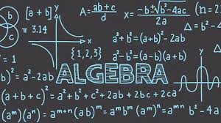
Algebra 1
Welcome to Algebra 1! This course is your gateway to…
Variables
Algebraic expressions
Equations
Inequalities
Functions, and their diverse representations.
Throughout this class, you'll hone your skills in exploring and solving real-world application problems, while also mastering the art of communicating mathematical ideas clearly. Algebra 1 establishes a robust foundation for mathematical literacy, setting the stage for success in all your future mathematical endeavors. Get ready to embark on an empowering mathematical journey!

Slide 9
Language Arts
Middle School Language Arts program is an exciting journey where communication takes center stage through the dynamic interplay of reading, writing, listening, and speaking.
In this immersive experience, students master…
Logical expression through engaging writing
Public speaking
Expanding vocabulary to enhance grammar proficiency
Fiction and non-fiction writing
Research and citing sources

Slide 10
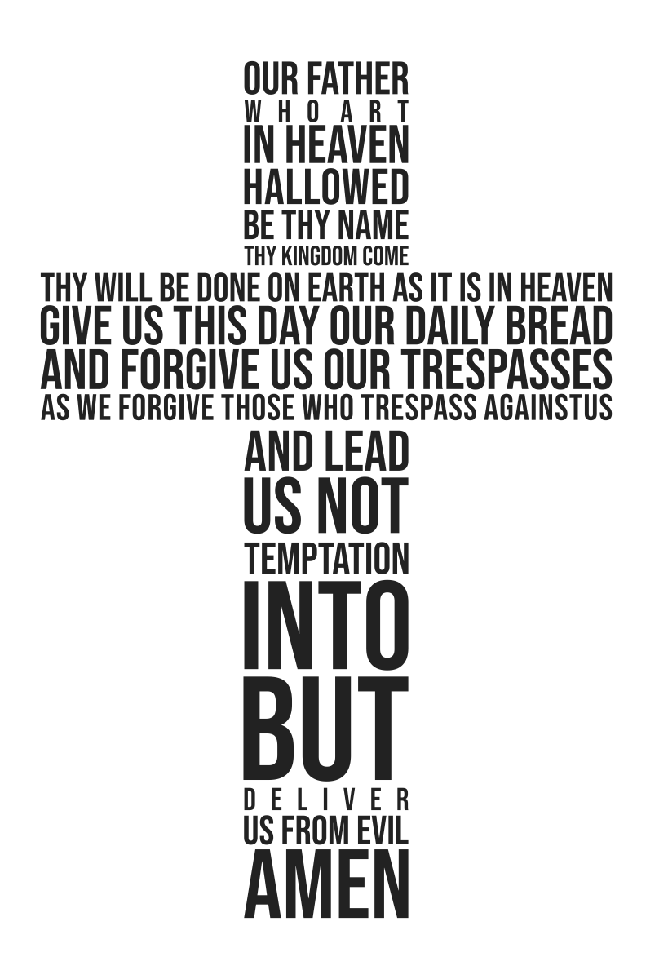
Leadership
In our dedicated leadership class, students explore…
Individual strengths
Setting meaningful goals for personal growth
The curriculum goes beyond mere practice, offering insights into different leadership styles and techniques.

Slide 11
Physical Education
Demonstrate competency in a variety of motor skills and movement patterns.
Apply knowledge of concepts, principles, strategies and tactics to movement and performance.
Demonstrate the knowledge and skills to achieve and maintain a health-enhancing level of physical activity and fitness.
Exhibit responsible personal and social behavior that respects self and others.
Recognize the value of physical activity for health, enjoyment, challenge, self-expression, and social interaction.

Slide 12
Extra Curricular Activities
Student Council
Volleyball
Soccer
Basketball
Ashland Drama
Basketball
Swiminators Swim Team
Golf
Baseball
Softball
Chess
Tennis (coming next school year)
Notes:
Volleyball
Soccer
Golf – like last year
Tennis – it’s coming next year from the golf people
Ashland Drama
Basketball
Baseball
Softball
Swimming
Chess – finding a coach

Slide 13
Why PreK - 8th grade?
Allows children to naturally mature in their faith
Students perform at higher academic achievement compared to traditional middle school students
Students experience more impactful leadership opportunities
Students often experience significantly less social and emotional challenges
Provides a safe community where students can navigate adolescence in an environment where they are known and loved
Shared history that creates lifelong friendships
Notes:
Volleyball
Soccer
Golf – like last year
Tennis – it’s coming next year from the golf people
Ashland Drama
Basketball
Baseball
Softball
Swimming
Chess – finding a coach

